Slide 1
Greedy Engineer
Name: Md. Foysal Mahmud.
Roll: 14CSE028.
Department of Computer Science & Engineering.

Slide 2
Introduction:
In real life, we face some problem that we wants the best result or profits to spend minimum cost. Its seems us like greedy but in the future, this approach makes us to do any works perfectly. Now in the following statements, I created a scenarios to understand a real life problem which we faced every day.

Slide 3
Problem Statements:
Mr. Snowden is a greedy Engineers. His job is to repair road among some cities. By doing this job, he wants to earn maximum profits. But the problem is that, His INSTRUCTOR given the road repair ‘days’ and there is also given the cost of road repair. So if Mr. Snowden wants to make more profits, then he has to work on that roads which repair cost is maximum. But the days are limited. So he has to look after the amount of days of that road repair.

Slide 4
Problem Statements:
The instructor is not good. So he sometimes moderate the road connection of the city. He can “ADD” connection between two cities and also “DELETE” any random connection of two cities. The instructor also can “UPDATE” any connection of that city.
Now find out the maximum profits Mr. Snowden can earn within the INSTRUCTOR given days.

Slide 5
Sample Input | Sample Output
5 4 1 2 280 4 2 5 200 4 2 3 120 1 3 4 150 3 | Maximum Profits: 600 Lakh.

Slide 6
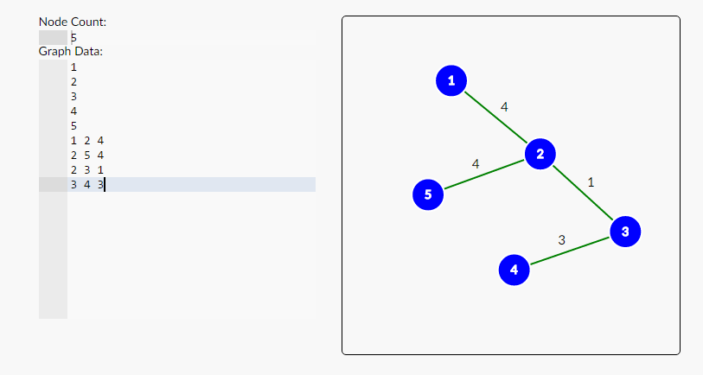
Graph created by Days:

Slide 7
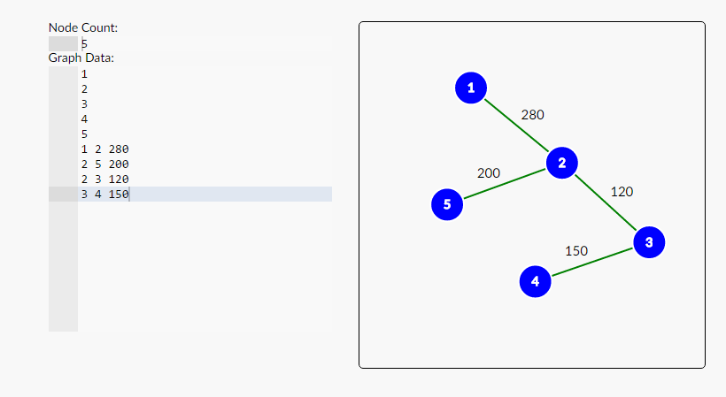
Graph created by Repair Cost:

Slide 8
Picture of my Project:
Here is some screen-sort of my project……….

Slide 9
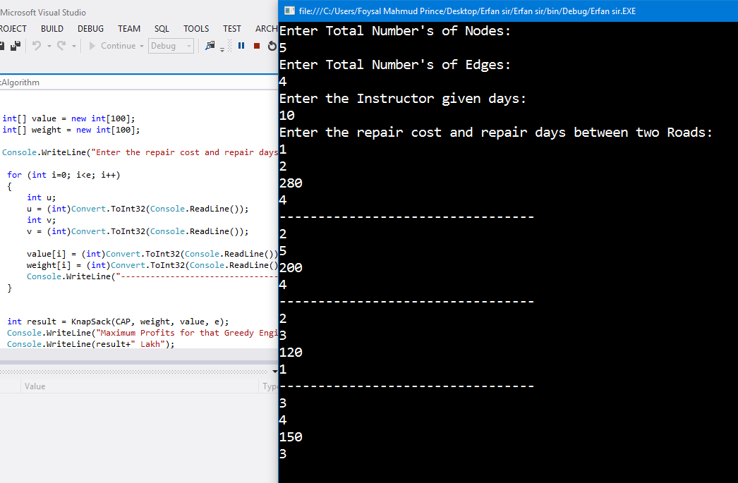

Slide 10
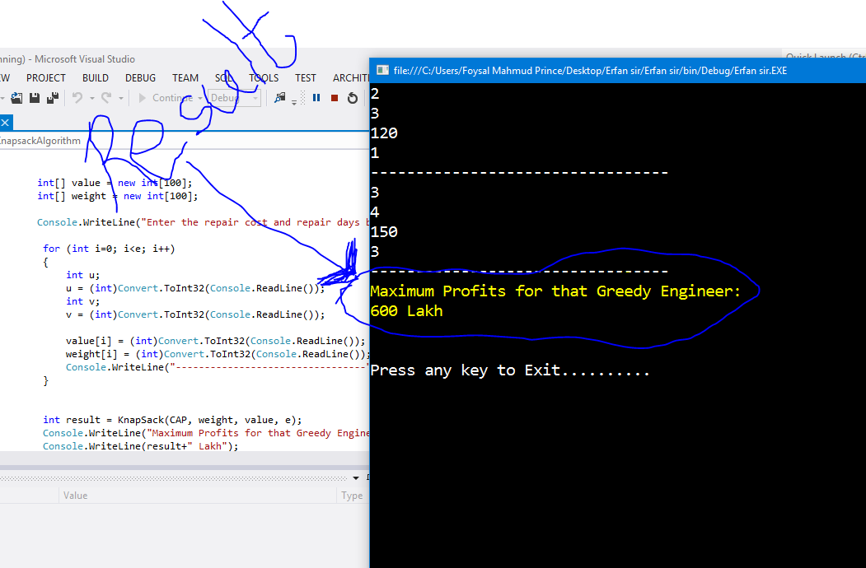

Slide 11
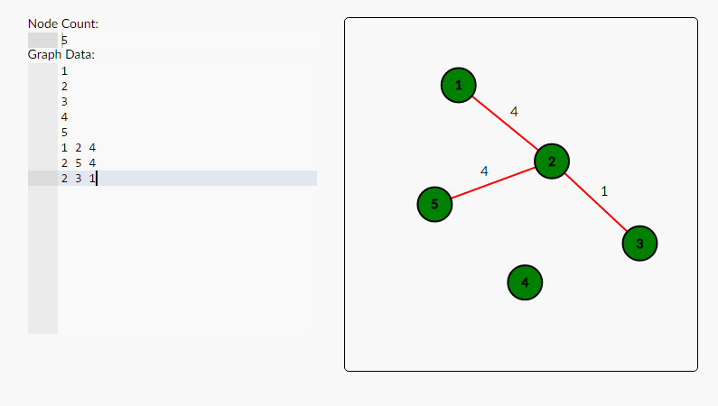
Maximum days needed: 9 Days

Slide 12
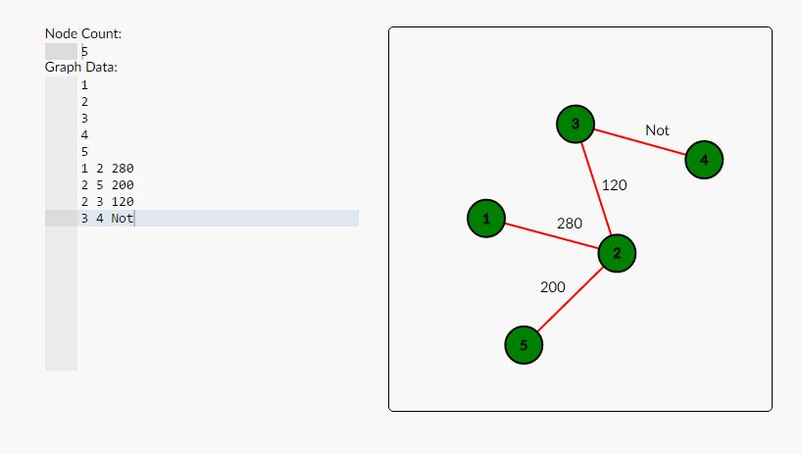
Maximum Profits: 600 Lakh

Slide 13
Motivation:
This problem is seems to be real life problem. Like this problem statement, we also use this solution techniques to solve this kinds of problem to get more profits. Like the road repairs construction, we can use this techniques to by something from a store where our bag weight is limited.

Slide 14
Conclusion:
This problem can be developed in a software where we can get the answer by just one click. This problem is based on Graph algorithm and greedy approach from Dynamic programming.
My future purpose is to developed this simple algorithm to a software by using any developed language.

Slide 15


